Slide 1
Business Data Management Capstone Project
Driving Growth: A Data-Centric Approach for ‘MK Tea Stall’
Name-Abhishek Darji
Roll Number-22F1000678

Slide 2
Contents
Executive Summary
Data Collection and Cleaning
Data Analysis
Findings
Recommendation

Slide 3
Executive Summary
The project focuses on Tea and Snacks selling shop located near Charotar University of Science and Technology, Changa, Gujarat. The business is B2C and deals in the segment of Food Service Industry. The business focuses on selling refreshment at near by college area and to the remote.
The issues were addressed by analyzing the data via different statistical and analytical approaches to gain the positive insights and create a new market strategy to resolve the current issues of the organization.

Slide 4
Data Collection and Cleaning
The data was collected on a daily basis and was collected by manually asking for the specific requirements.
The data comprises of sales data and waste and demand data of everyday business that was carried out. The selected dataset spans one month, it starts from 01-March-2024 to 31- March-2024.
The data was then entered into excel sheets and converted into useful datasets.
Three datasets were collected during the whole collection span. The three datasets are-
1. Sales data
2. Waste and demand data
3. Monthly Expenditure data

Slide 5
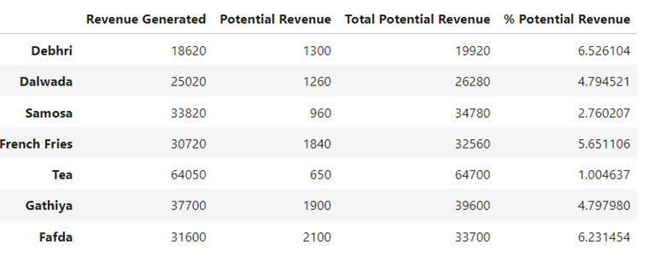
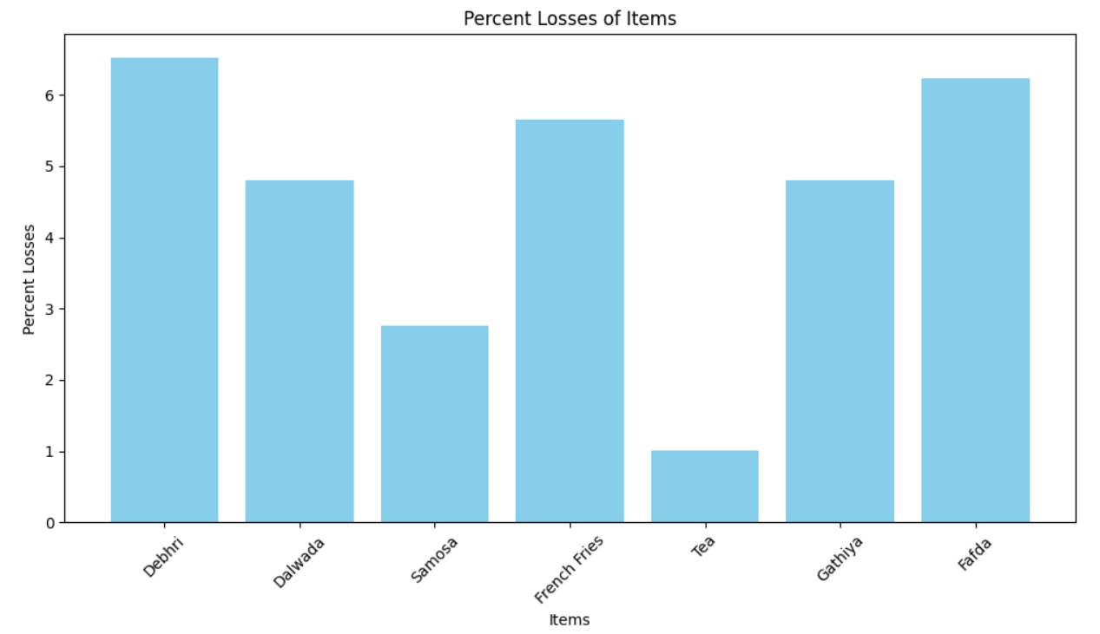
Data Analysis
Problem statement 1: To manage the current inventories as the per sales required and minimizing the waste.
Inventory management becomes an important factor for the above shown products
Analysis of purchase data reveals a strategic allocation of resources in raw materials, adhering to the principles of the Bar chart shown above. Fafda and Debhri, emerges as the undisputed leader, commanding the most wasted product as per revenue.

Slide 6
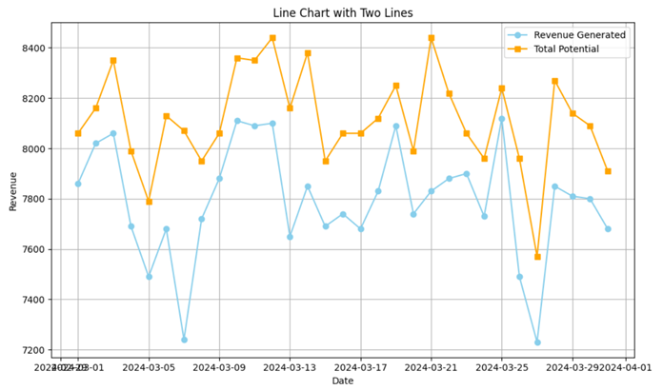
Data Analysis
Problem statement 2: To improve the profit margins.
Total Revenue vs Potential Revenue
Insights and Learning-Potntial Loss incurred is ultimately the minimization of profit ratios. Minimizing the gap between both the line ultimately will lead into rise in increase of profit ratios.

Slide 7
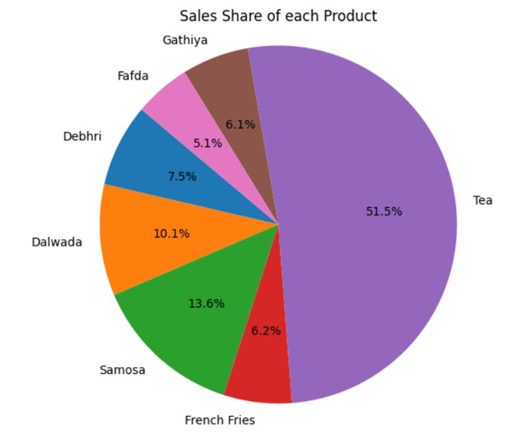
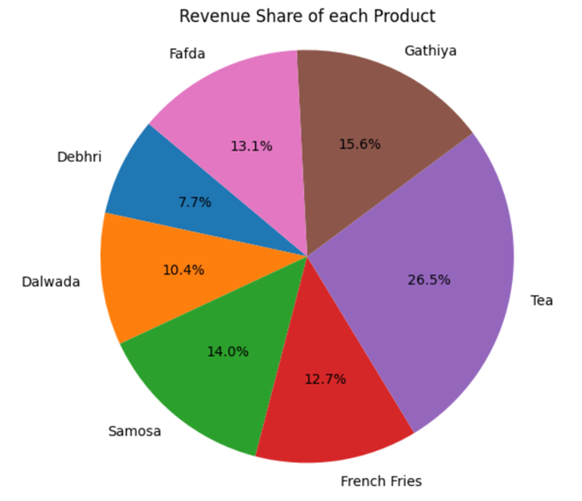
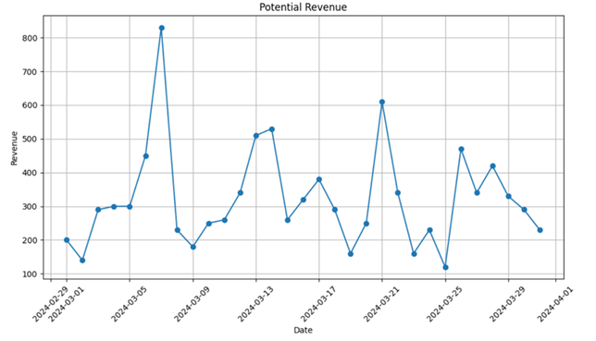
Data Analysis
Problem statement 3: To get better data analytical approach to learn more about the operational inefficiencies
Insights and Learnings : Although the Sales share chart shows a different picture, Revenue share shows a different picture. Also The potential revenue plays an important factor in operational inefficiencies.

Slide 8
Findings
Versatility and widespread purchase across the entire month justify the substantial investment needed to secure optimal supply.
The amount of products that were short or were wasted were relative to the ones that are produced and hence the impacts negatively on the production.
Analysis of purchase data reveals a strategic allocation of resources in raw materials, adhering to the principles of analysis.
The potential for leveraging insights to optimize inventory management and promotional strategies for high-impact products
Customers churning ratio change on the day-to-day basis leads to change in sudden variation.
Non-availability of raw materials in the remote area during high demands leads to shortage.

Slide 9
Recommendation
An in-depth examination of products leading to potential losses sheds light on areas ripe for optimization. Whether due to shortages or wastage, addressing these inefficiencies is paramount to maximizing revenue and minimizing losses. By bridging the gap between supply and demand, MK Tea Stall can capitalize on untapped revenue streams and bolster its bottom line.
Leveraging predictive analytics to anticipate shifts in consumer behavior enables the company to stay ahead of the curve and adapt its inventory management practices accordingly.
Operational inefficiencies often stem from discrepancies in product performance and demand dynamics. By scrutinizing sales patterns and demand trends, MK Tea Stall can fine-tune its operations and streamline its inventory management processes.

